Slide 1
National Economic Education Delegation
Vision
One day, the public discussion of policy issues will be grounded in an accurate perception of the underlying economic principles and data.
Mission
NEED unites the skills and knowledge of a vast network of professional economists to promote understanding of the economics of policy issues in the United States.
NEED Presentations
Are nonpartisan and intended to reflect the consensus of the economics profession.

Slide 2
The Michigan Front in the Trade War: Michigan’s Role in International Trade and Its Vulnerability to Recent Trade Policies
Alan V. Deardorff
University of Michigan
For presentation at Adult Learning Institute
Oakland Community College
April 30, 2019

Slide 3
Outline
Features of Michigan’s Trade
President Trump’s 2018 Trade Actions
Trade War
Solar Panels and Washing Machines
Steel and Aluminum
Cars (threat)
China
Free Trade Agreements
Korea-US Trade Agreement Amended
NAFTA → USMCA

Slide 4

Features of Michigan’s Trade

Slide 5
Features of Michigan’s Trade
Michigan
Trades more than most states
Mostly exports and imports cars and car parts
Trades most with Canada and Mexico

Slide 6
Top US Trading States: 2017 (Exports + Imports)
By Value, $bil.
1 | California | 613
2 | Texas | 528
3 | New York | 205
4 | Illinois | 201
5 | Michigan | 200
6 | New Jersey | 147
7 | Florida | 130
8 | Georgia | 129
9 | Washington | 126
10 | Pennsylvania | 122
By Average* Rank
1 | Michigan
2 | Texas
3 | Louisiana
4 | Illinois
5 | Kentucky
6 | Tennessee
7 | New Jersey
8 | Indiana
9 | South Carolina
10 | California
Per GDP
1 | Louisiana | 40.1
2 | Michigan | 39.3
3 | Kentucky | 38.5
4 | Texas | 32.1
5 | Tennessee | 32.1
6 | South Carolina | 31.4
7 | Indiana | 26.2
8 | Illinois | 24.5
9 | New Jersey | 24.4
10 | Washington | 24.1
*Weighted average, with weights 1/3 on Value and 2/3 on Per GDP

Slide 7
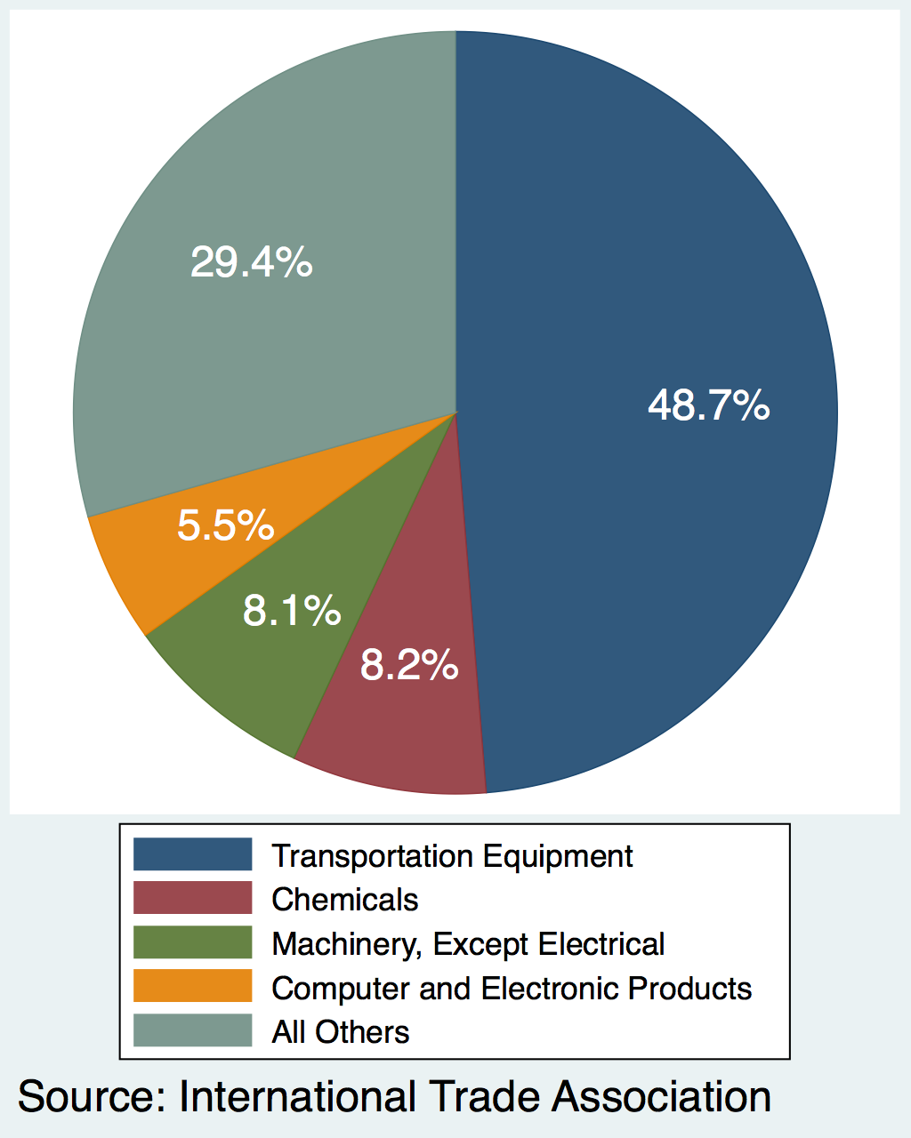
Michigan Exports, by Product: 2017
Product | Value ($ B)
Transportation Equipment | $29.2
Chemicals | $4.9
Machinery, Except Electrical | $4.9
Computer and Electronic Products | $3.3
All Others | $17.6
Grand Total | $59.9
Source: International Trade Administration
Notes:
2017 NAICS Total All Merchandise Imports to Michigan from World
ITA http://tse.export.gov/stateimports/ChartDisplay.aspx

Slide 8
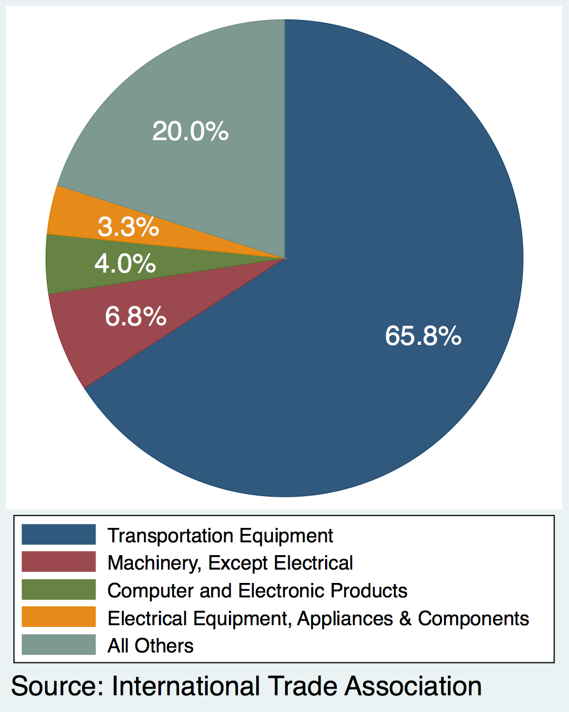
Michigan Imports, by Product: 2017
Product | Value ($ B)
Transportation Equipment | $92.3
Machinery, Except Electrical | $9.5
Computer and Electronic Products | $5.6
Electrical Equipment, Appliances & Components | $4.7
All Others | $28.1
Grand Total | $140.2
Source: International Trade Administration

Slide 9
Michigan’s Rank among States in 2017 Trade with
Top 5 Exporters to North America per GDP
North Dakota | 9.8
Michigan | 7.3
Texas | 7.3
Indiana | 5.2
Kentucky | 4.9
North America |  | Value ($) | Per GDP
 | Exports | 3 | 2
 | Imports | 2 | 1
China |  | Value ($) | Per GDP
 | Exports | 9 | 11
 | Imports | 14 | 20
Top 5 Importers from North America per GDP
Michigan | 19.7
Montana | 8.0
Vermont | 7.3
New Hampshire | 7.2
Texas | 6.6
Europe |  | Value ($) | Per GDP
 | Exports | 18 | 22
 | Imports | 13 | 13
Compare: Michigan’s rank by GDP: #14

Slide 10


Slide 11
Trump’s 2018 Trade Actions
Most were tariffs on imports
Taxes levied by US on imports from others
Taxes levied by others (in retaliation) on US exports
Normal effects of tariffs
Raise prices for importers
Lower prices for exporters
Cause substitution
To other products
To other countries (if not on all)
Net economic effect is almost always negative
Net economic effect is always negative
Two recent studies of the 2018 Trade War found that exporter prices did not fall.

Slide 12
Trump’s 2018 Trade Actions
These slides will list only actions actually done.
Most had plans and threats announced in the days and weeks beforehand.

Slide 13
Trump’s 2018 Trade Actions
Jan 22, 2018: Safeguard tariffs
30% on solar panels
50% on washing machines

Slide 14


Slide 15
Tariffs on Washing Machines
Who benefits?
Whirlpool, Benton Harbor, MI, which requested the tariffs
Whirlpool brands include Amana, Maytag, & more
Other US manufacturers, such as GE, Electrolux and Frigidaire (Swedish), Equator, Speed Queen
In 2017, Samsung and LG announced plans to build factories in South Carolina and Tennessee
Notes:
https://www.greentechmedia.com/articles/read/trump-solar-tariffs-manufacturing-renaissance#gs.T145hk31

Slide 16
Tariffs on Washing Machines
Who is hurt?
Consumers
Washers (and dryers!) both increased in price by about 12% (per Flaaen et al. 2019)
Note that the tariff was levied on washers only, not dryers]
”consumers bore between 125 percent and 225 percent of the costs” (NYT 4/21/19)
US appliance prices (I don’t have graph for washing machines alone) rose 8.1% over the 12 months to Nov 2018
Notes:
https://www.marketwatch.com/story/buying-washing-machines-dishwashers-is-more-expensive-after-trump-tariffs-2018-11-14

Slide 17
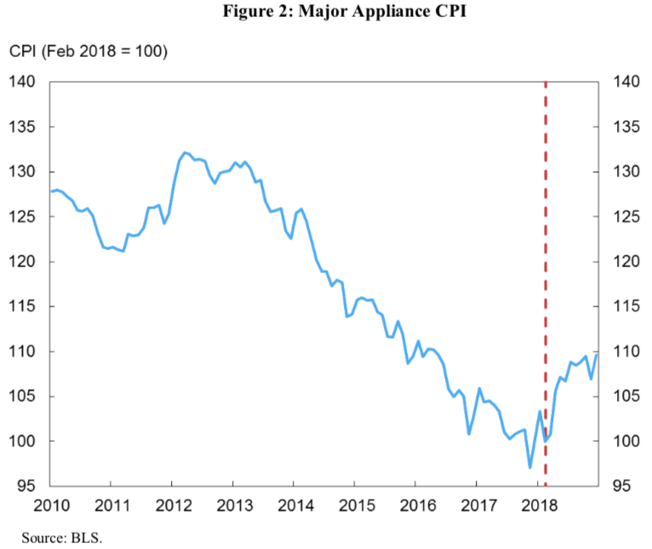
Tariffs on Washing Machines
Tariff
Source: Amiti, Redding, and Weinstein, “The Impact of the 2018 Trade War on U.S. Prices and Welfare,” CEPR Discussion Paper DP13564, March 1, 2019.
Notes:
https://www.marketwatch.com/story/buying-washing-machines-dishwashers-is-more-expensive-after-trump-tariffs-2018-11-14
https://www.nber.org/papers/w25767
https://www.nytimes.com/2019/04/21/business/trump-tariffs-washing-machines.html

Slide 18


Slide 19
Trump’s 2018 Trade Actions
Jan 22, 2018: Safeguard tariffs
Mar 1, 2018: Announces “national-security” tariffs on steel and aluminum
25% on steel, 10% on aluminum
Announced for all countries
Some delayed (EU, Canada Mexico)
Others later exempted (S. Korea)

Slide 20
Tariffs on Steel and Aluminum
Responses to metals tariffs
Retaliation by China, EU, Canada, & others
WTO disputes
May-Aug: Complaints filed against US
Jul: Complaints filed by US

Slide 21
Tariffs on Steel and Aluminum
Who benefits?
US producers of steel and aluminum
Steel: AISI lists 12 producers in Michigan
AISI = American Iron & Steel Institute
Aluminum: Thomas lists 76 suppliers in Michigan
Notes:
https://www.thomasnet.com/nsearch.html?cov=MI&heading=1261809&loc=MI

Slide 22
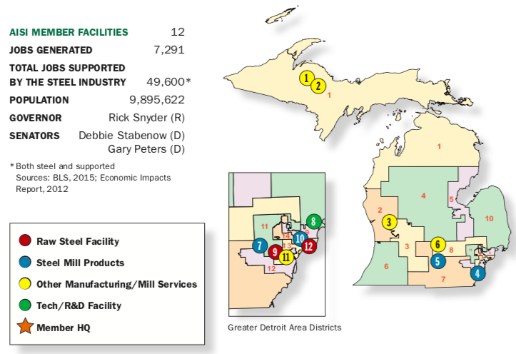
Steel Produced in Michigan

Slide 23
Tariffs on Steel and Aluminum
Who is hurt?
US users of steel and aluminum pay higher prices
Most obviously the car companies but many others

Slide 24
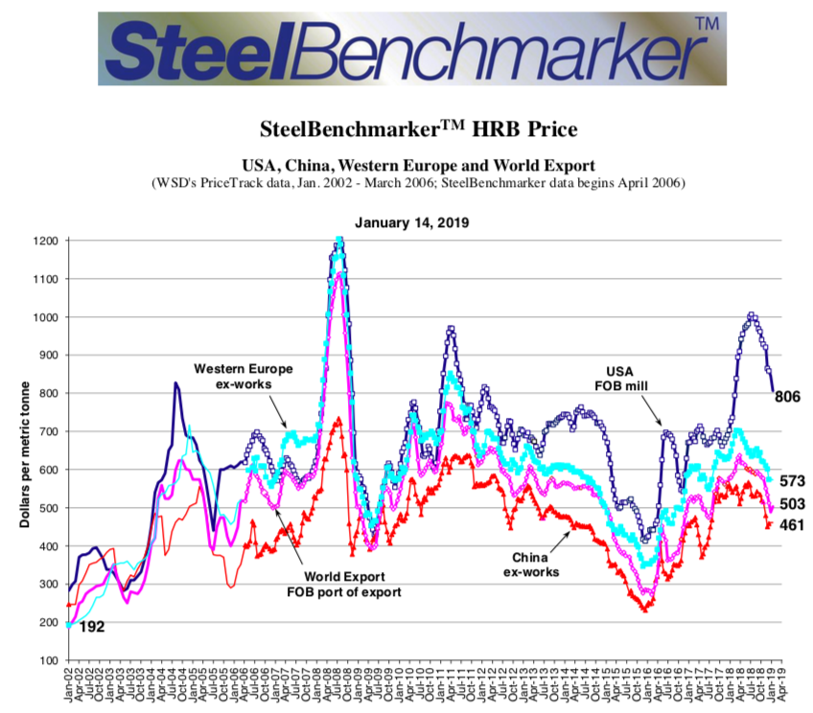
Steel Prices
US 25% Tariff
24

Slide 25
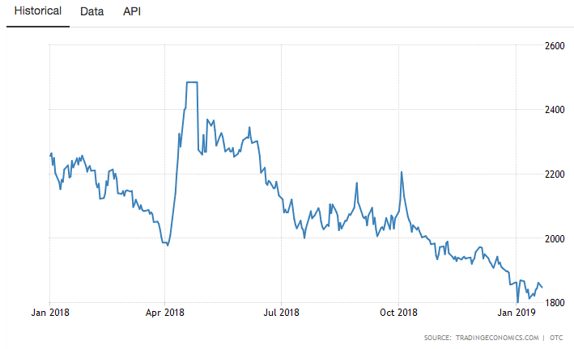
Aluminum Price
US 10% Tariff
25%

Slide 26
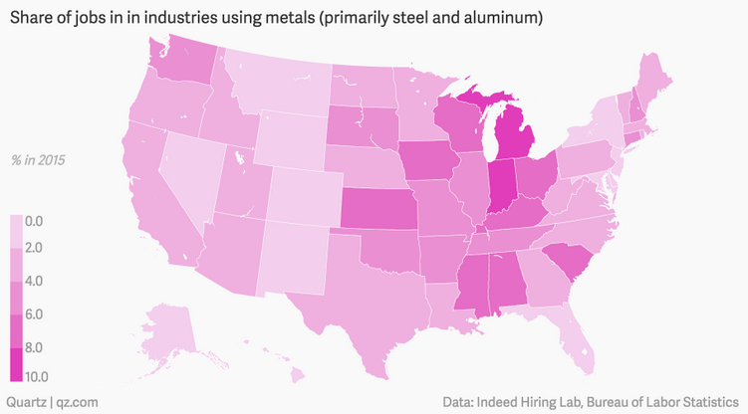
Source: Kopf (2018)
Notes:
Kopf, Dan, “The US states that will be helped and hurt by Trump’s tariffs,” Quartz, March 9, 2018.
https://qz.com/1224271/the-us-states-that-will-be-helped-and-hurt-by-trumps-tariffs/

Slide 27


Slide 28
Trump’s Trade Actions
Jan 22, 2018: Safeguard tariffs
Mar 1, 2018: Announces tariffs on steel and aluminum
May 23, 2018: Initiates Commerce Dept investigation of car and car part imports

Slide 29
Tariff on Cars and Car Parts
Who would benefit?
US car companies?
Most (e.g., GM) are opposed
I can’t find objection from Ford, but others list Ford among those who object
US auto workers?
UAW has spoken in favor of “target measures” with with understanding that broad tariffs or quotas “could cause harm” including “mass lay-offs for American workers.”
Notes:
https://www.freep.com/story/money/cars/2018/07/19/hearing-auto-import-taxes-get-underway-washington/797915002/
https://www.forbes.com/sites/jimhenry/2018/07/23/with-friends-like-these-auto-import-tariffs-do-not-need-enemies-trade-group-says/#1ebddc9669ab
https://www.politico.com/story/2018/06/26/us-automakers-trump-administration-car-tariffs-653654
https://www.businessinsider.com/trump-auto-car-tariffs-ford-bmw-gm-toyota-kia-reaction-2018-7

Slide 30
Tariff on Cars and Car Parts
Who would be hurt?
Most car companies, including GM
US car buyers

Slide 31
Tariff on Cars and Car Parts
Estimated Effects on Car Sales and Prices of 25% Tariff
 | Sales impact (units) | Average Price Increases ($/unit) on vehicles sold in US
Tariff on: |  | All | US-assembled | Imported
All imports | –2.0 M | $4,400 | $2,270 | $6,875
Canada & Mexico exempted | –1.2 M | 2,450 | 1,135 | 3,980
Source: Center for Automotive Research
Notes:
https://www.cargroup.org/wp-content/uploads/2018/07/NADA-Consumer-Impact-of-Auto-and-Parts-Tariffs-and-Quotas_July-2018.pdf
Schultz et al., “Trade Briefing: Consumer Impact of Potential U.S. Section 232 Tariffs and Quotas on Imported Automobiles & Automotive Parts,” July 2018

Slide 32
Tariff on Cars and Car Parts
Estimated Effects on Employment & GDP of 25% Tariff
Tariff on: | Total US Employment | US GDP
All imports | –714.7 K | –$59.2 B
Canada & Mexico exempted | –197.2 K | –15.3B
Source: Center for Automotive Research
Notes:
https://www.cargroup.org/wp-content/uploads/2018/07/NADA-Consumer-Impact-of-Auto-and-Parts-Tariffs-and-Quotas_July-2018.pdf
Schultz et al., “Trade Briefing: Consumer Impact of Potential U.S. Section 232 Tariffs and Quotas on Imported Automobiles & Automotive Parts,” July 2018

Slide 33
Tariff on Cars and Car Parts
Estimated Effects of a 25% Tariff on Revenue & Employment in New Car Dealerships
Tariff on: | Dealership Revenues |  | Dealership Employment
 | Total | Per D’ship | Total | Per D’ship
All imports | –66.5 B | –4.0 M | –117.5 K | –7
C & M exempted | –39.1 B | –2.3 M | –50.5 K | –4
Source: Center for Automotive Research
Notes:
https://www.cargroup.org/wp-content/uploads/2018/07/NADA-Consumer-Impact-of-Auto-and-Parts-Tariffs-and-Quotas_July-2018.pdf
Schultz et al., “Trade Briefing: Consumer Impact of Potential U.S. Section 232 Tariffs and Quotas on Imported Automobiles & Automotive Parts,” July 2018

Slide 34
Tariff on Cars and Car Parts
Where we stand:
Commerce Dept. sent report to Trump Feb 17
Not public, but said to include several options for tariffs
Trump has 90 days to decide
FT Jan 22: “president was leaning towards slapping tariffs on automotive imports, in the hope of forcing Brussels to further open the EU market to American farm products.”
Notes:
https://www.ft.com/content/a852539e-19d7-11e9-9e64-d150b3105d21
https://www.msci.org/commerce-department-recommends-section-232-tariffs-on-autos-auto-parts/

Slide 35


Slide 36
Trump’s Trade Actions
Mar 1, 2018: Announces tariffs on steel and aluminum
May 23, 2018: Initiates Commerce Dept investigation of car and car part imports
Jul 6, 2018: First tariffs on China, $34 billion
On $34 billion of China exports to US
Based on unfair trade practices in intellectual property (IP)

Slide 37
China
Concerns about China’s IP practices pre-existed Trump
Theft of technology secrets
Forcing investors in China into joint ventures and sharing technology
Prior to Trump, complaints had been voiced by US and EU, but nothing had been done
US initiated investigation under Section 301 of US trade law (unfair trade practices)
Aug 18, 2017: Investigation initiated
Mar 22, 2018: Report finds unfair trade and recommends tariffs
Since then, Trump has announced and then implemented multiple rounds of tariffs

Slide 38
Trump’s Trade Actions
Mar 1, 2018: Announces tariffs on steel and aluminum
May 23, 2018: Initiates Commerce Dept investigation of car and car part imports
Jul 6, 2018: First tariffs on China , $34 billion
Aug 23, 2018: Second tariffs on China, $16 billion
Sep 24, 2018: Third tariffs on China, $200 billion

Slide 39
China
This is a “Trade War”: Tariffs and retaliation
US tariffs on $34 billion Jul 6 were matched that day by China tariffs on $34 billion of US exports
US tariffs on $16 billion Aug 23 were matched that day by China tariffs on $16 billion of US exports
US tariffs on $200 billion Sep 24 were less-than-matched by China on $60 billion of US exports
Trump said he’d use tariffs on still more ($267 billion), approaching all of China’s exports to US
Did not do that; delayed for China-US trade talks

Slide 40
China
What’s the point?
To get China to stop its IP practices?
To reduce the US bilateral trade deficit with China?
To stop China’s rise as an economy and as a world power?
Who will “win”?
Nobody! Everybody loses from tariffs
Trump says it’s “easy to win” because he measures success from trade deficit

Slide 41
Tariffs
41

Slide 42
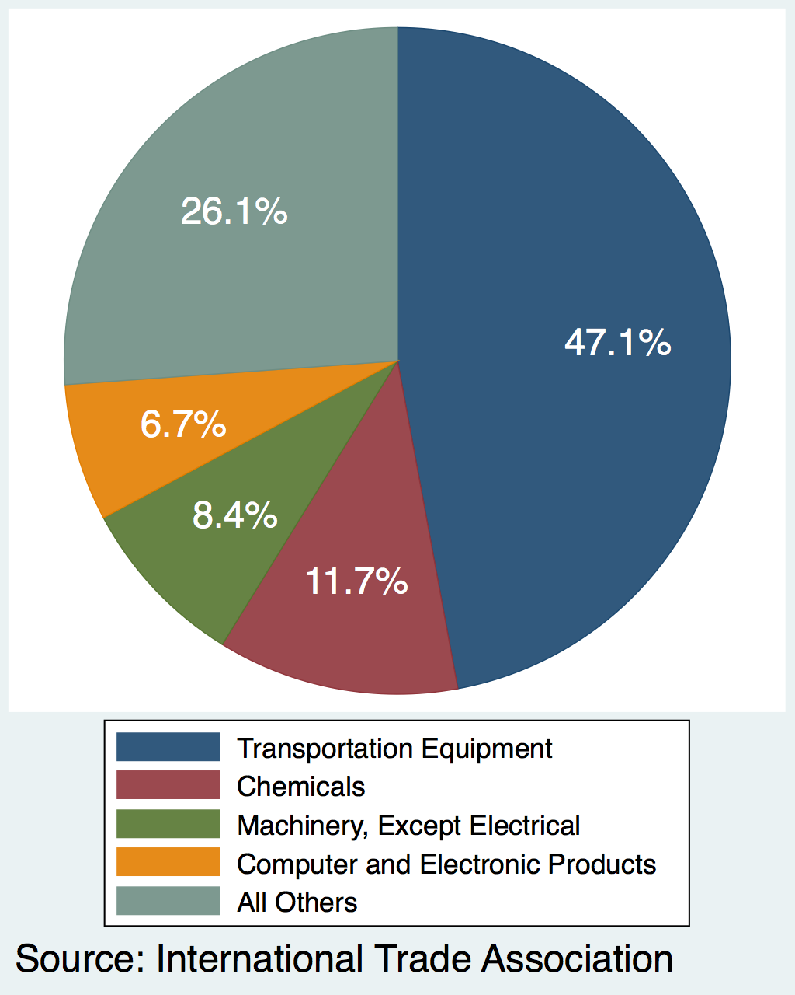
Michigan Exports to China, by Product: 2017
Product | Value ($ B)
Transportation Equipment | $1.7
Chemicals | $0.4
Machinery, Except Electrical | $0.3
Computer and Electronic Products | $0.2
All Others | $1.0
Grand Total | $3.7
Source: International Trade Administration

Slide 43
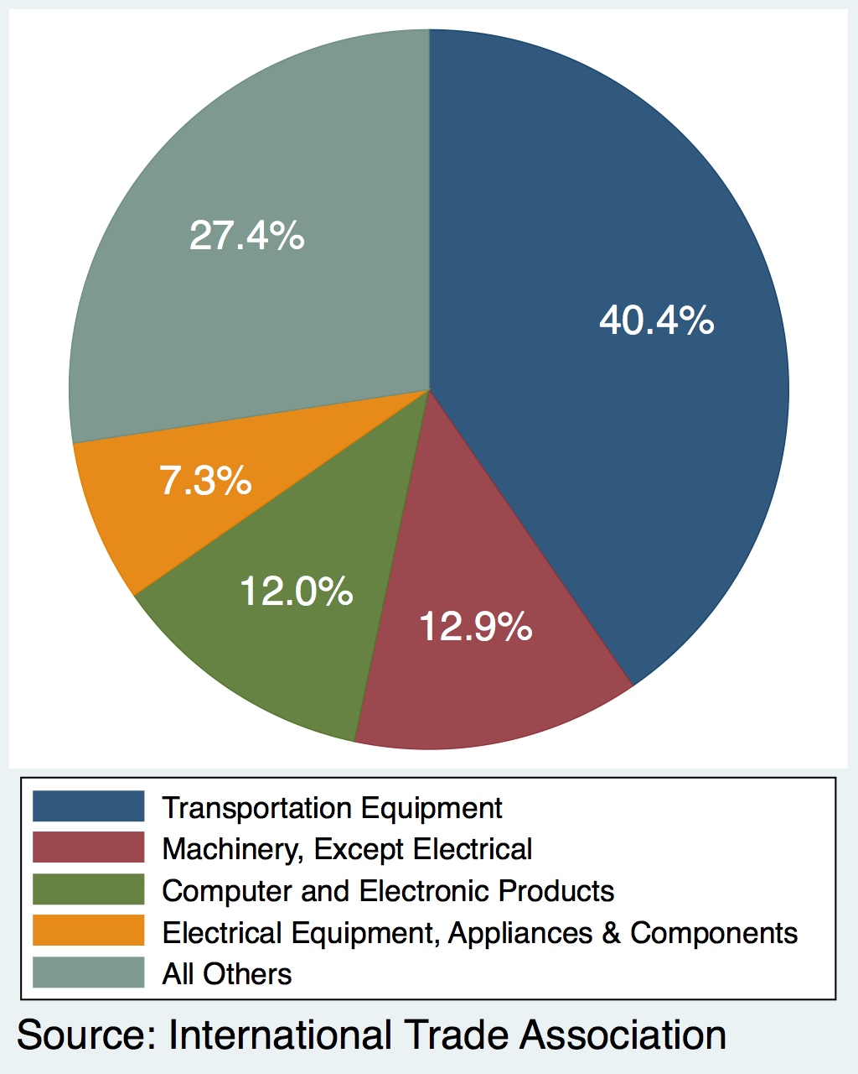
Michigan Imports from China, by Product: 2017
Product | Value ($ B)
Transportation Equipment | $3.9
Machinery, Except Electrical | $1.2
Computer and Electronic Products | $1.1
Electrical Equipment, Appliances & Components | $0.7
All Others | $2.6
Grand Total | $9.6
Source: International Trade Administration

Slide 44
China
Bottom line for Michigan
Trade war with China does not appear to hurt Michigan any more than most states
Michigan’s exports to China won’t respond much to China’s tariffs
(Compare to soybean exporters, who compete with Brazil)
Michigan’s imports from China are mostly similar to other states’
Some can be bought from other countries

Slide 45


Slide 46
Trade War
Effects of the 2018 Trade War
US average tariffs rose, in 6 waves
Prices of imports in US rose
Quantity of imports fell
Number of imported varieties fell
Source: Amiti, Redding, and Weinstein, “The Impact of the 2018 Trade War on U.S. Prices and Welfare,” CEPR Discussion Paper DP13564, March 1, 2019.

Slide 47
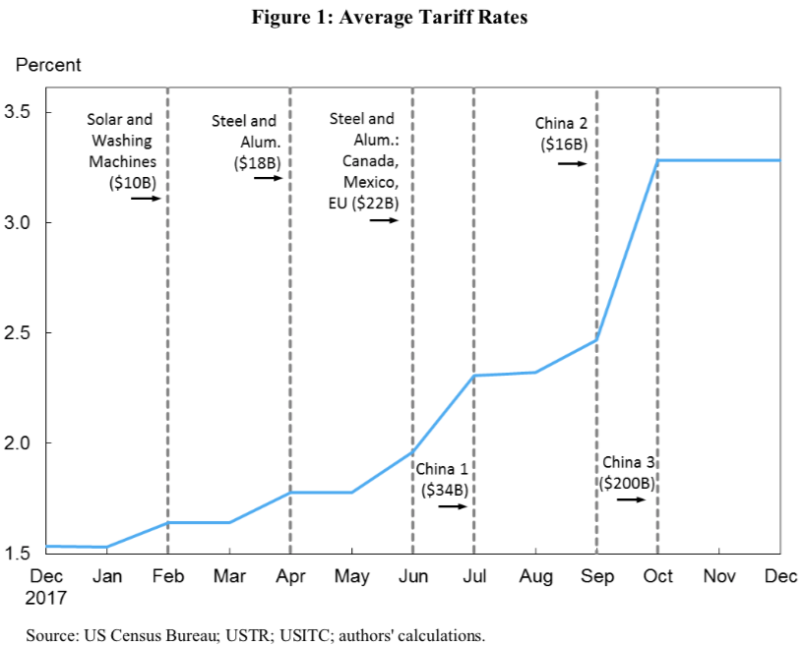
Trade War
Waves of tariffs:
1 2 3 4 5 6
Source: Amiti, et al. 2019.

Slide 48
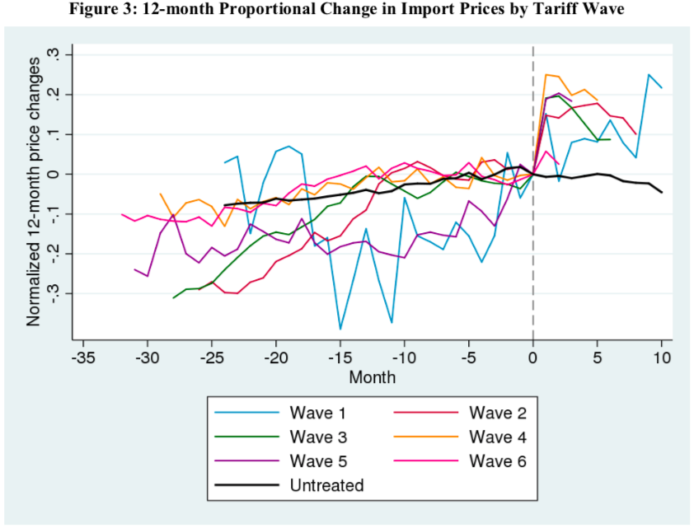
Trade War
Source: Amiti, et al. 2019.

Slide 49
Trade War
Effects of the 2018 Trade War
Effects varied across US
US tariffs hit Michigan, hard
Foreign tariffs did not hit Michigan hard
Real wages fell most in states other than Michigan
Source: Fajgelbaum, Goldberg, Kennedy, and Khandelwal, “The Return to Protectionism,” March 3, 2019.

Slide 50
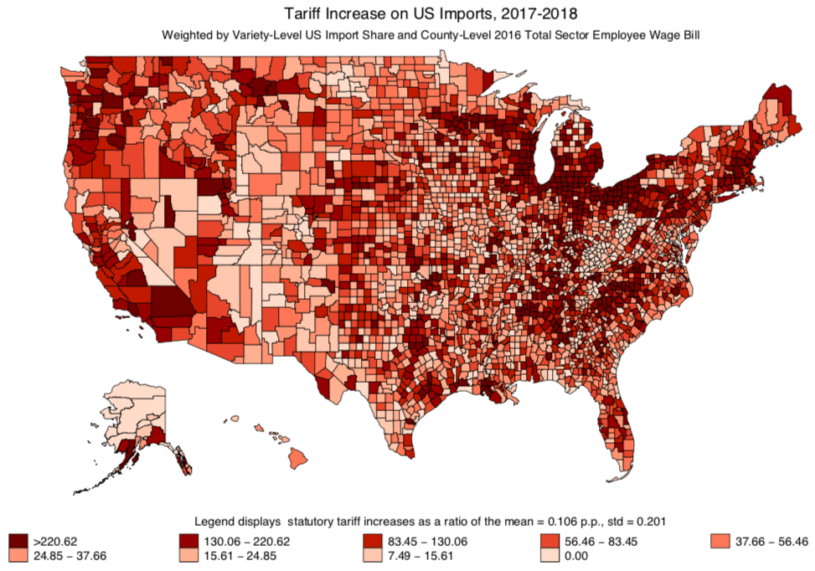
Trade War
Tariff Increase on US Imports
Source: Fajgelbaum, et al. 2019.

Slide 51
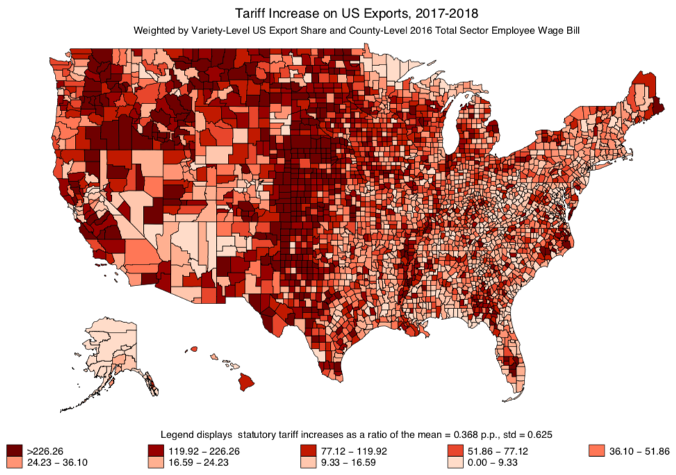
Trade War
Tariff Increase on US Exports
Source: Fajgelbaum, et al. 2019.

Slide 52
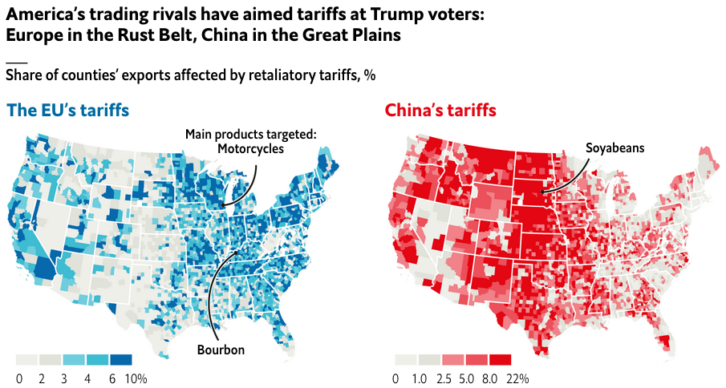
Trade War
Tariff Increases on US Exports: EU vs China
Source: Economist 4/27/19
Notes:
https://www.economist.com/graphic-detail/2019/04/27/why-you-should-never-start-a-trade-war-with-an-autocracy

Slide 53
Talks

Slide 54
Trade War
Talks
China-US Trade Talks, I
Talks began in May 2018, in response to Trump’s threat of tariffs
China promised to import more from US and allow more foreign investment
Said to have “averted trade war”
But then talks broke off in early June
Trade war with China Jul, Aug, Sep 2018

Slide 55
Trade War
Talks
China-US Trade Talks II
Oct 2018: US and China postured about renewing trade talks
Nov 1, 2018: New round of talks began with phone call from Trump to Xi
Dec 2, 2018: G20 Summit dinner agrees truce: No more tariffs while talks continue
Talks are still underway, but said to be approaching a deal

Slide 56

Trade War
Talks
China-US Trade Talks II: Calendar
Nov 9: He & Mnuchin talk by phone
Jan 7-9: Talks in Beijing
Jan 30-31: Talks in DC
Feb 11-15: Talks in Beijing
Feb 21-24: Talks in DC
Mar 28-29: Talks in Beijing
Apr 3-5: Talks in DC
Apr 23-?: Talks in Beijing
May 8-?: Talks in DC
Source:
Notes:
https://www.china-briefing.com/news/the-us-china-trade-war-a-timeline/

Slide 57
Trade War
Trade talks open
Exploring deal
Accord is near
Talks
Closer to final trade agreement
China-US Trade Talks II: Headlines
Feb 21, FT: A potential new snag in the US-China trade talks
Feb 23, WSJ: China Trade Talks Extended as Trump Pushes to Close the Deal
Feb 28, WSJ: U.S. Drops Threat of 25% Tariffs on Chinese Goods in Sign That Accord Is Near
Mar 4, WSJ: U.S., China Close In on Trade Deal
Mar 8, FT: Trump prepared to walk away from ‘bad’ China trade deal
Mar 8, NYT: Chinese Officials Becoming Wary of a Quick Trade Deal
Mar 18, NYT: Trade Fight With China Enters Overtime, With Tariffs a Costly Sticking Point
Mar 28, FT: US-China trade talks could stretch for ‘months’ — Kudlow
Apr 3, FT: US and China draw closer to final trade agreement
Apr 4, FT: US and China push back timing of possible trade deal
Apr 14, NYT: Mnuchin Says China Trade Talks Are Nearing Final Round
Apr 26, NYT: Trump Says Xi Jinping of China Will Visit Soon, Stirring Anticipation of a Completed Trade Deal
Nov 29, WSJ: U.S., China Exploring Deal to Ease Trade Tensions
Dec 4, WSJ: Trump Names Lighthizer to Run U.S.-China Negotiations
Dec 30, FT: China and US hail ‘positive progress’ on trade talks
Jan 7, WP: Trade talks open in Beijing amid optimism about an end to U.S.-China dispute
Jan 9, FT: China and US strike upbeat tone after talks but offer few details
Jan 22, FT: US turns down China offer of preparatory trade talks
Jan 24, FT: US commerce secretary Ross says US ‘miles’ from a trade deal with China
Jan 29, WSJ: Big Divides Remain as U.S.-China Trade Talks Resume
Jan 31, FT: Donald Trump says US-China trade talks ‘going well’
Feb 6, WSJ: Agriculture Execs Say U.S.-China Trade Deal Nearing
Feb 13, WSJ: China, U.S. Seek Broad Outline of a Trade Pact This Week
Feb 15, FT: US-China trade talks end with little sign of progress
Feb 16, WSJ: Chinese, U.S. Trade Negotiators Inch Toward a Broad Agreement
‘Miles’ from a trade deal
Talks could stretch for ‘months’
Trade deal nearing
Little sign of progress
Anticipationof a completed trade deal

Slide 58
Trade War
Talks
China-US Trade: Issues of Negotiation
Government subsidies to state-owned companies
Chinese purchases of U.S. farm and energy products and services
China’s market-opening efforts in sectors such as financial services and manufacturing
Improving its protection of U.S. intellectual-property rights
Pressure on U.S. companies to share technology
Industrial policies that favor state-controlled companies
Currency stability
Regulatory relief for foreign companies in China
How to enforce any agreements on the above
Reimpose tariffs, or
Leave them in place

Slide 59
Trade War
Talks
What Might a China-US Trade Deal Include?
US wants (per FT, 3/25/19):
Huge Chinese purchases of US exports, to reduce US trade deficit
Liberalization of market access for US goods and services
Reform of Chinese industrial policy, especially “forced transfers” of IP
US permitted to use punitive tariffs if these are violated, without China retaliating or complaining to WTO
China wants:
Removal of US tariffs
Notes:
https://www.ft.com/content/58f098fc-6201-11e9-b285-3acd5d43599e

Slide 60


Slide 61
Trump’s Trade Actions
Aug 23, 2018: Second tariffs on China, $16 billion
Sep 24, 2018: Third tariffs on China, $200 billion
Sep 24, 2018: Amended KORUS signed
Sep 30, 2018: USMCA agreed
NAFTA renegotiation had completed previously with Mexico
Now Canada signed on, and name changed (by Trump) to USMCA
USMCA: U.S.-Mexico-Canada Trade Agreement

Slide 62
NAFTA → USMCA
NAFTA is
Free Trade Agreement (FTA)
Zero tariffs on goods traded by US, Canada, Mexico
Only if they satisfy Rules of Origin (ROOs)
Additional provisions regarding many things
Services trade
Foreign direct investment
Intellectual property rights
Dispute settlement
Government procurement

Slide 63
NAFTA → USMCA
USMCA will be (if approved)
FTA with stricter ROOs
Some changes in NAFTA’s additional provisions
New rules for environment, labor, financial services, digital trade
Weakening of Canada’s dairy barriers
Discouragement of trade with China
Provision for renegotiation (sunset)

Slide 64
NAFTA → USMCA
Most important for Michigan: Tighter ROOs for cars and car parts
North American content increased from 62.5% to 75%
Intended to reduce inputs from outside N. America, likely benefiting Mexico
New requirement that 40-45% of content must be from labor paid $16/hr or more (but does not rise with inflation)
Intended to reduce inputs from low-wage Mexico, benefiting US and Canada

Slide 65
NAFTA → USMCA
Effects of tighter ROOs
If ROOs are
Satisfied: Higher costs of production
Not satisfied: Tariffs on traded inputs and final products
Either way
Prices rise
Demand falls
Products become less competitive internationally
Effects on demands for labor ambiguous throughout

Slide 66
NAFTA → USMCA
Will USMCA be ratified?
Needs ratification in all three countries
In US, there are problems
Democrats want changes
Stronger enforcement of labor provisions
Remove tariffs on steel and aluminum
Approval requires a report from USITC, delayed by government shutdown, but was issued Apr 18
Trump threatens to issue six-month withdrawal notice from NAFTA
Notes:
https://www.ft.com/content/6f1b275a-1b43-11e9-9e64-d150b3105d21

Slide 67
NAFTA → USMCA
USITC Report Main Findings
Positive impact on US real GDP and employment
Raise GDP by 0.35%
Raise employment by 0.12 %
Most significant effects from
Reduced uncertainty in digital trade
Rules of origin in auto sector
Auto sector
Increase in US production
Small increase in prices and reduced demand
Notes:
https://www.usitc.gov/press_room/news_release/2019/er0418ll1087.htm

Slide 68

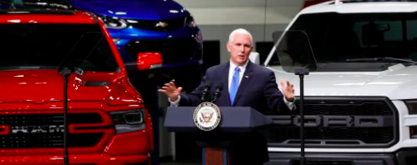
NAFTA → USMCA
News from Michigan
April 24, MLive:
Notes:
https://www.mlive.com/news/2019/04/trumps-trade-deal-wins-big-praise-from-michigans-big-three-automakers.html?utm_source=am-newsletter&utm_medium=headline-link&utm_campaign=test&utm_content=headline

Slide 69


Slide 70
Conclusion
Trump’s trade actions in 2018
In all states, but especially Michigan
Raise prices to consumers
Raise costs to producers
Alienate other countries

Slide 71
Conclusion
May they serve any purpose?
Not to reduce trade deficit(s)
Tariffs may reduce both exports and imports
They do not change overall trade balance
Mar 6, 2019, NYT:
“The United States trade deficit in goods ballooned to its largest level in history, reaching $891.3 billion in 2018, despite President Trump’s repeated promise to reduce that figure.”

Slide 72
Conclusion
May they serve any purpose?
Perhaps to motivate other countries to change policies for the better
US is negotiating with
China, to change their IP policies and increase imports from US
EU and Japan to open to more imports of agricultural goods from US

Slide 73
Thank you!
Any Questions?
Alan V. Deardorff
Ford School of Public Policy
University of Michigan
www.NEEDelegation.org

